Slide 1

DESTINATION MARKETING PROGRAM
2024/2025
INYO COUNTY
by Bishop Chamber of Commerce and Information Center

Slide 2
DESTINATION MARKETING PROGRAM
2024/2025
01.
US TRAVEL ASSOCIATION IPW CONFERENCE
REGISTRATION, MATERIALS, TRAVEL
02.
AIR SERVICE CAMPAIGN
Organic Social Posting
Datafy Marketing
03.
FALL COLORS CAMPAIGN
04.
EASTERN SIERRA FISHING GUIDE
$40K
+ BISHOP CHAMBER ADMIN
INVESTMENT

Slide 3

CONNECTIONS
This strategic mix of digital marketing, regional collaboration and fresh connections create a vital partnership between Inyo County and the
Bishop Chamber of Commerce and Information Center.

Slide 4


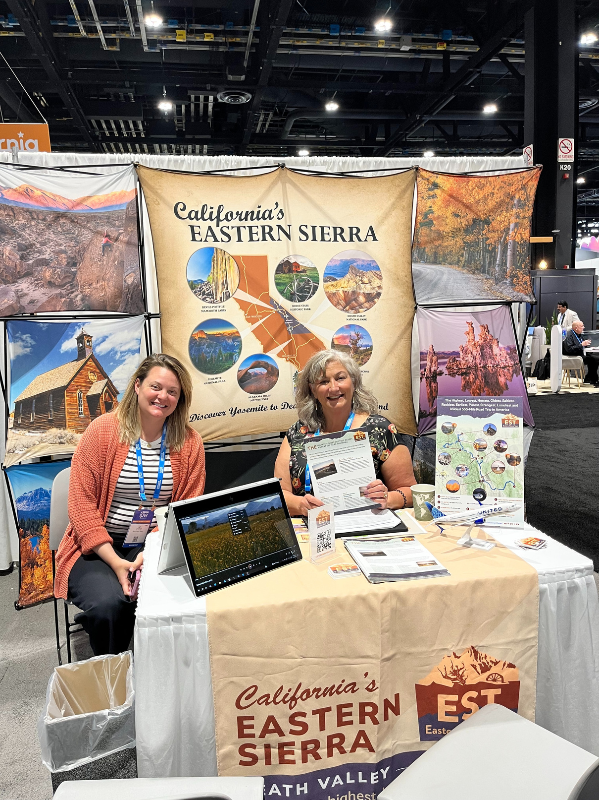

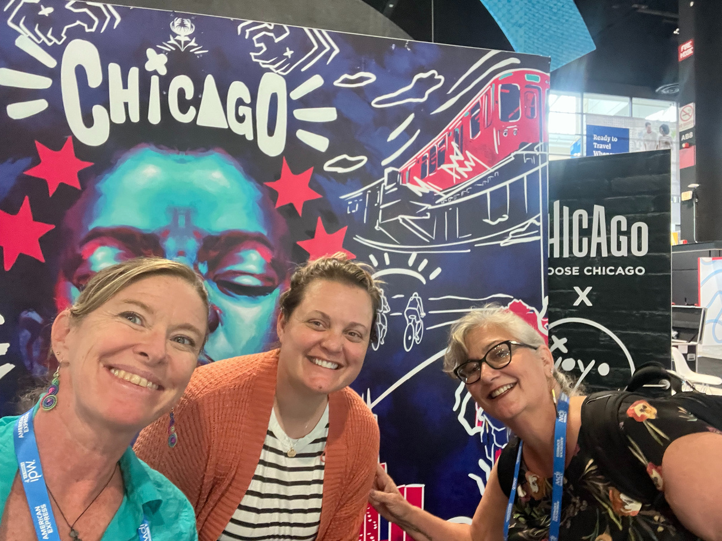
OLDEST
WILDEST
LOWEST
HIGHEST
EASTERN SIERRA TOUR
Our collaboration with Mono and Inyo Counties at IPW, the nation's premier travel marketplace, was a resounding success. We leveraged this vital platform to engage with over 5,000 international buyers and media. By showcasing a branded itinerary that features 10 iconic venues from Death Valley to Yosemite, we generated significant interest and secured meetings with over 40 key tour operators and media
from Europe, Mexico, Canada,
Brazil, Vietnam, and India.
JUNE 2025
IPW
$5K
INVESTMENT

Slide 5
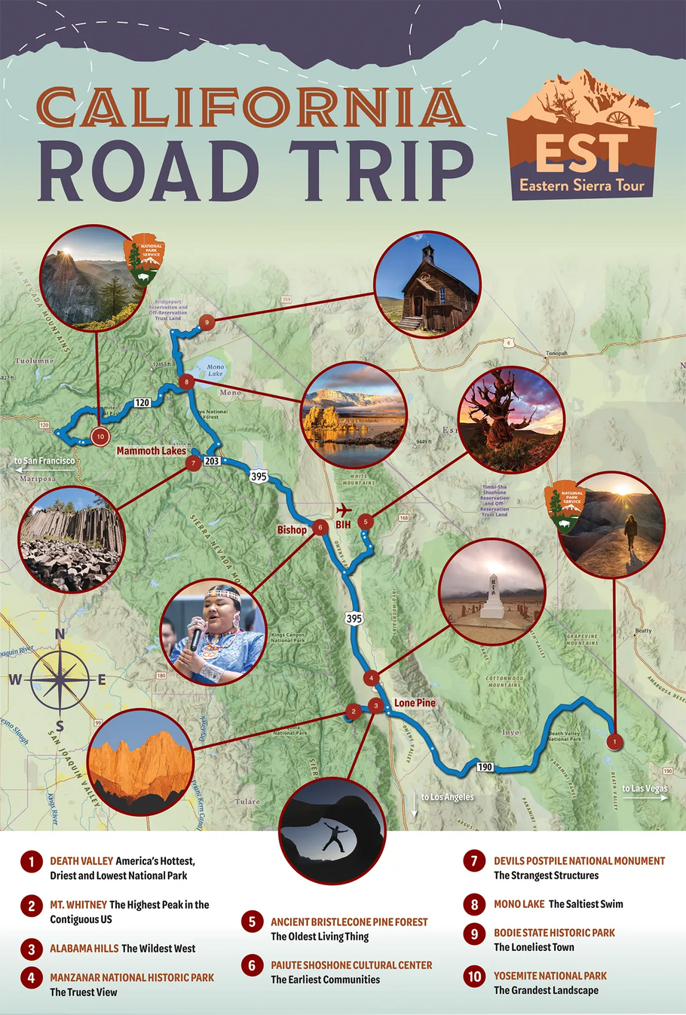
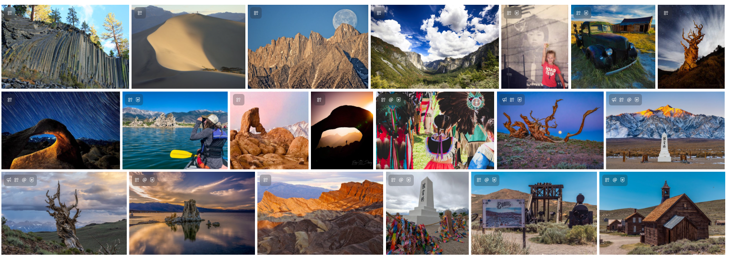
IPW
BUZZWORTHY MOMENTS
Tour operators are actively seeking partnerships with Destination CEOs and have the authority to book lodging directly.
Tour Operators: 8-14 night itineraries, want details for itineraries (where to eat, road stops, don’t miss along the way with an emphasis on wellness/gentle outdoorsy.
Flights: Ready to BOOK 18 months in advance.
Freelance Travel Writers: AFAR, Fodor’s, TIME, US News, San Francisco Chronicle, National Geographic, Wall Street Journal
More Int’l Media: Mexico City, Italy, France, Vietnam, Brazil

Slide 6

MOMENTUM
Air Service Campaign started in 2023 and yielded positive results. We took the next step and targeted past visitors seen in Bishop Lodging properties from September to November in 2021, 2022, & 2023. Plus added a look-a-like audience of past visitors we’ve seen at Bishop lodging properties and at the Bishop Airport. Then we collected additional data on ad-exposed visitors. This is what we discovered about the people who saw the ad, who showed up in person in our area:

Slide 7
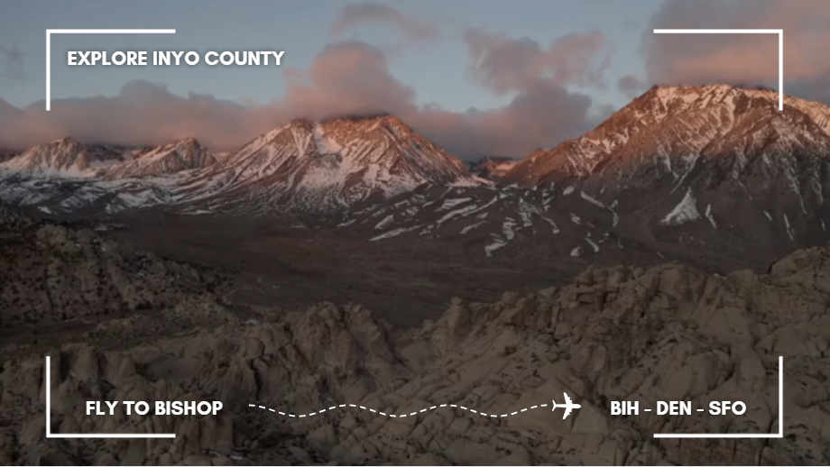
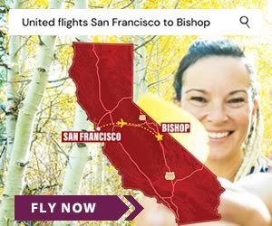
DATAFY
PAID ADS
ULTRA -TARGETED
For those served ads, these are attributable trips to Bishop
5 MONTH CAMPAIGN (Nov 24-Mar 25)
ATTRIBUTION CAMPAIGN
EST. CAMPAIGN IMPACT
EST. ROAS
EST. SPEND PER DAY
1.5 M
$615,747.00
$41 : $1
$163.55
Impressions
3,765
Total Trips
192K
Total Video/Audio Completions
$15K
INVESTMENT

Slide 8
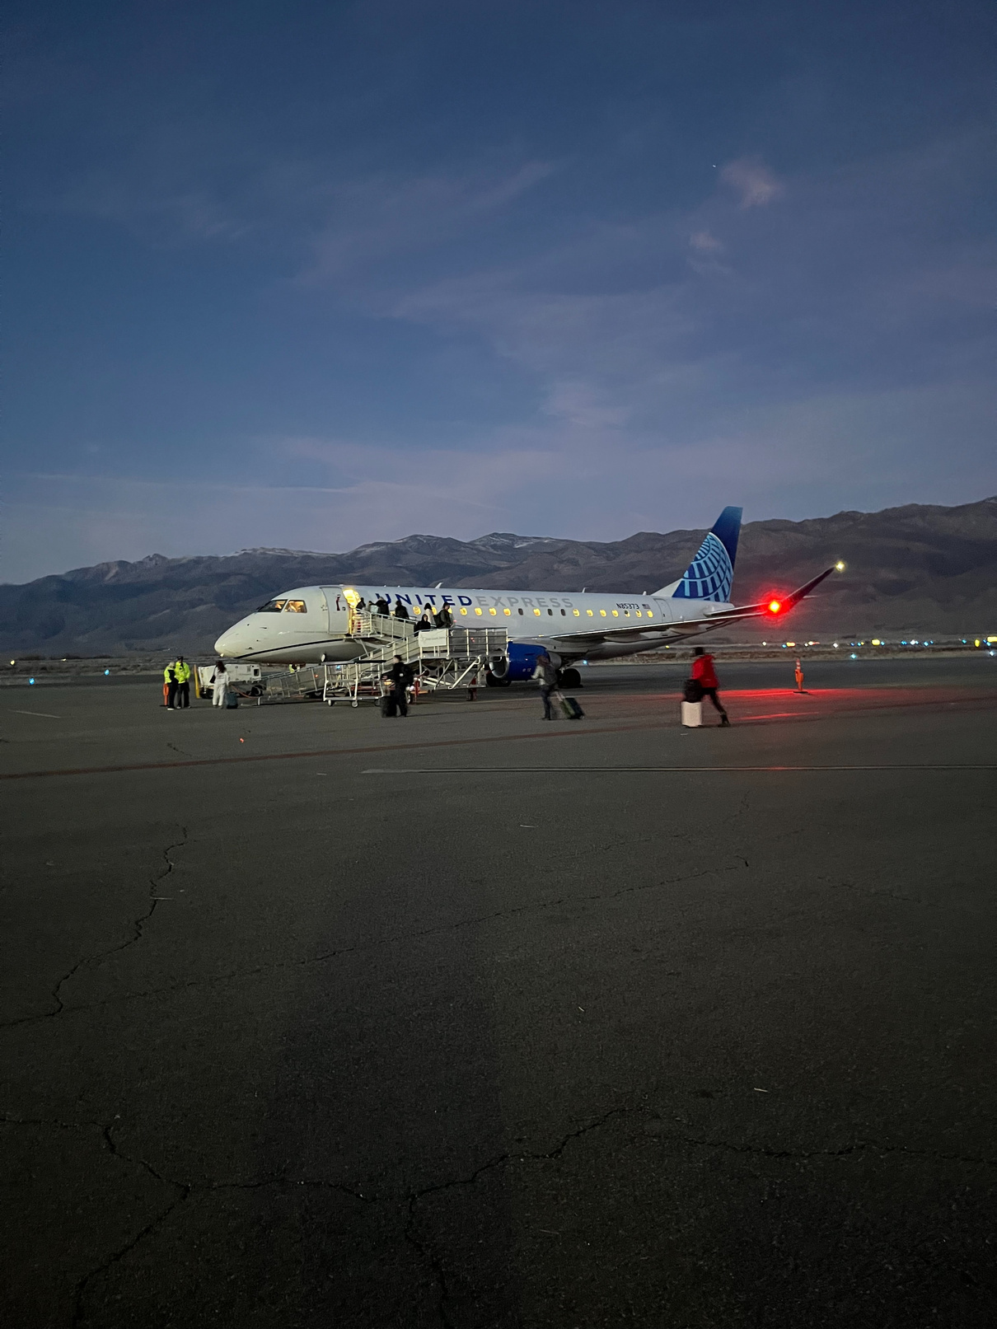
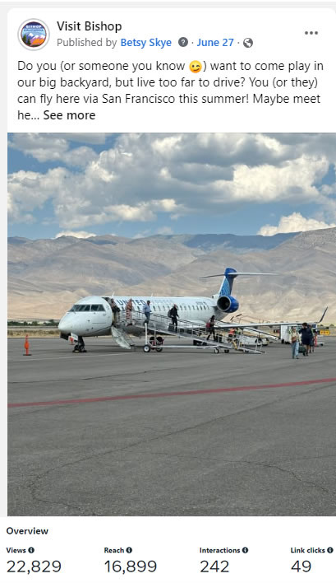



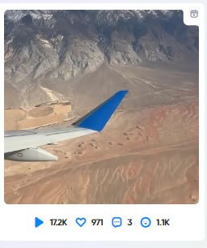
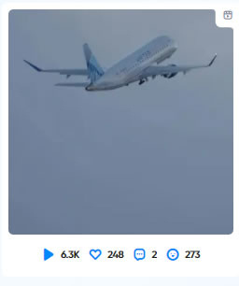
AIR SERVICE
ORGANIC SOCIAL POSTING
AIRPORT POSTS
2 POSTS/MONTH
CAMPAIGN
IG 41,585
FB 227,462
IG 85
FB 6,183
IG 8,623
FB 454
INSTAGRAM - 43K Followers
Reach - 1.4M
Post Views - 1.5M
Engagements - 125K
FACEBOOK - 70K Followers
Reach - 11.4M
Post Views - 11.5M
Engagements - 144K
$3K
6879
INVESTMENT

Slide 9

COLLABORATION
Weekly fall color reports are published and pushed out to nationwide major media partners.
This fall color map and guide is a key marketing piece for our destination storytelling; a joint effort supported by Inyo County, Mono County, Bishop Chamber and MLT.

Slide 10
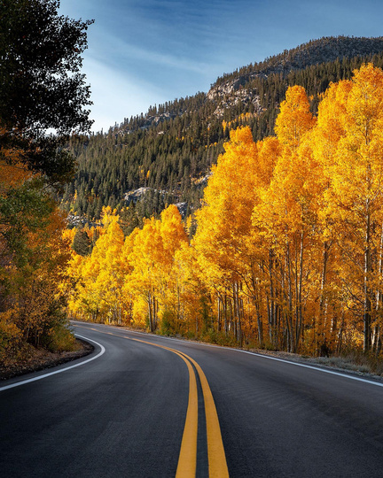


FALL COLOR CAMPAIGN
REPRINT
AD
REPORTS
Banner ad displayed on
Weekly Fall Color Reports are created and submitted to CaliforniaFallColor.com.
Starting (0-10%)
Patchy (10-50%)
Near Peak (Go Now!)
CALIFORNIAFALLCOLOR.COM
100K COPIES
1,152 CLICKS
PRICELESS
$6K
INVESTMENT

Slide 11
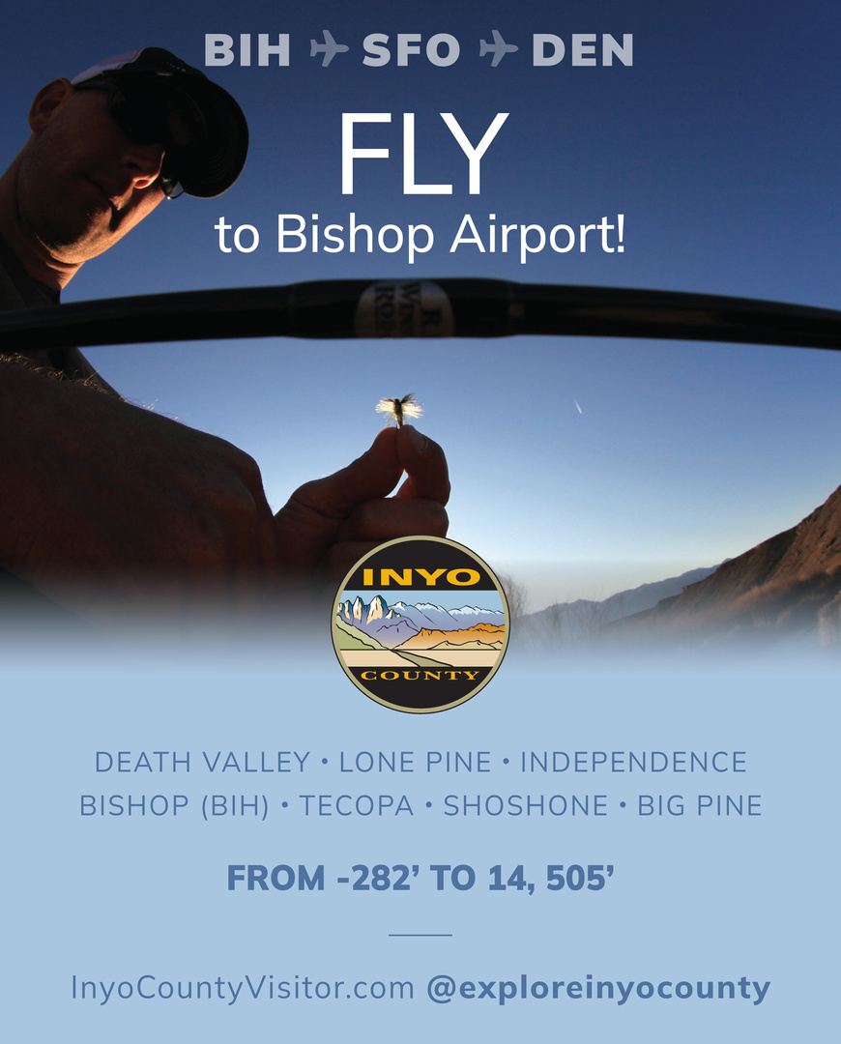
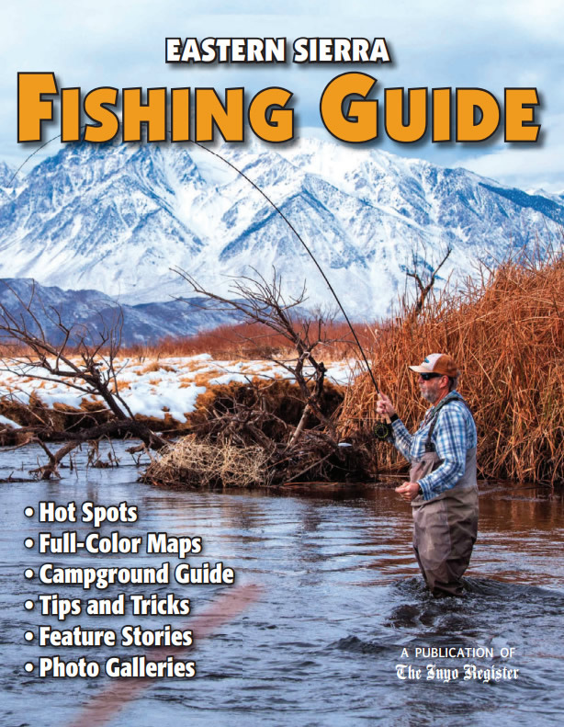
PRINT/DIGITAL FISHING GUIDE
Distributed all year at the visitor centers, hotels, campgrounds, retail shops and sport fishing shows.
$1K
INVESTMENT

Slide 12

FOMO
Let’s keep the connections, momentum, and collaboration growing!
execdir@bishopvisitor.com
bishopvisitor.com

